Slide 1
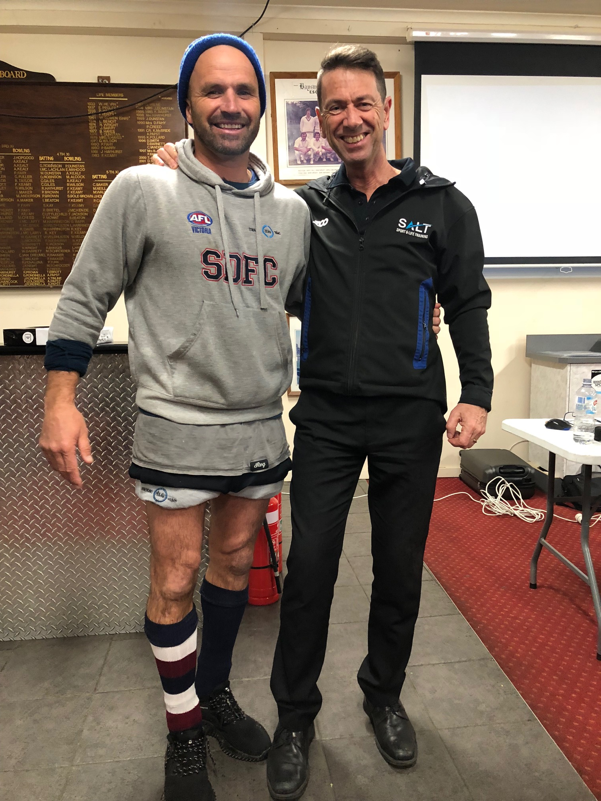
Notes:
In clubs we meet people like Mick (slide 1)

Slide 2
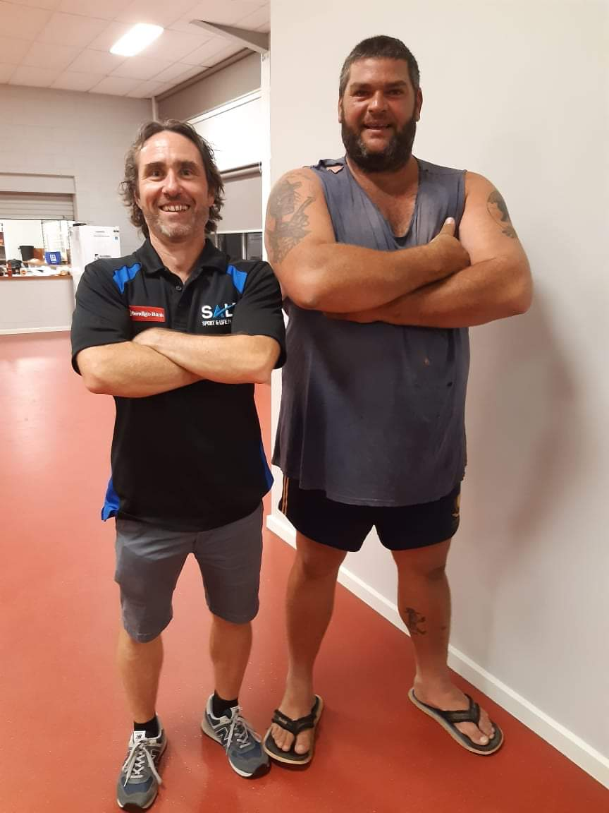
Notes:
and (slide 2) Shane
He wants to support his mates – (slide 3) we know that because his tattoo tells the story

Slide 3
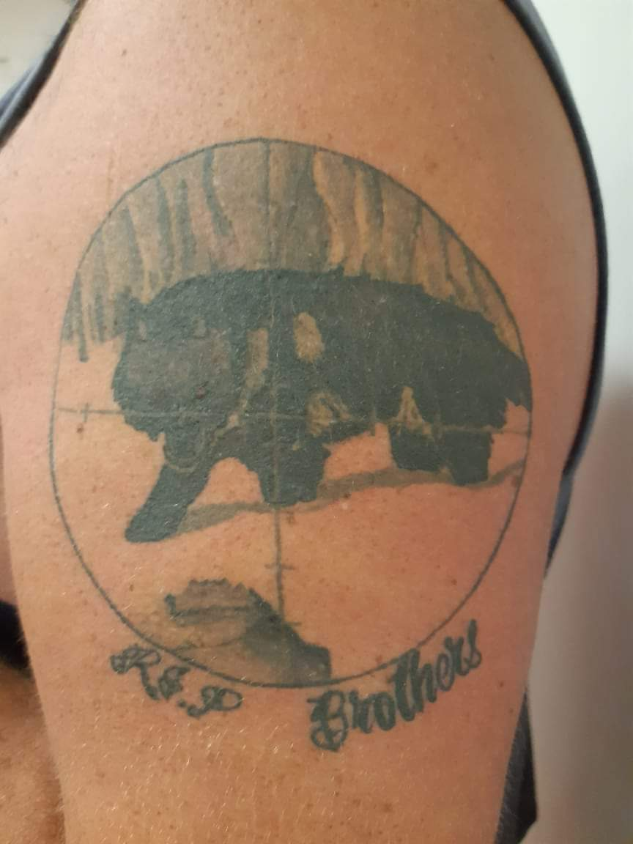

Slide 4
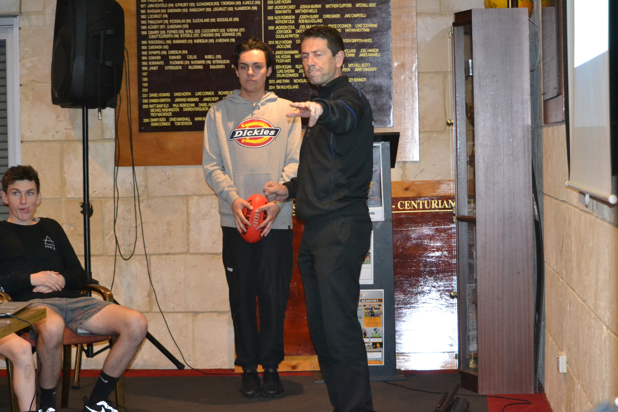
Notes:
Slide 4 We work with young men and older men (slide 5)

Slide 5
Notes:
I am going to tell you 2 stories and then summarise a few thoughts on what I think are the strengths and weaknesses of men sharing in their own spaces.

Slide 6
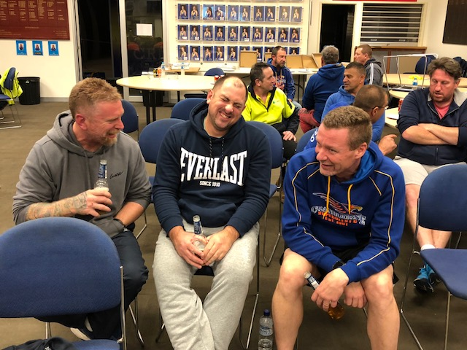
Notes:
Story of Frankston Tiger Sharks Vets – aged 35 – 55 (slide 6)
Why were they so open? It was their space, they knew each other well, they had a lot in common, they were all old but not too old, they shared a love of footy, they were lubricated with alcohol, they knew that there was no requirement for political correctness. Even with me, the outsider speaking into their space, it was their space and they would determine the tone.

Slide 7
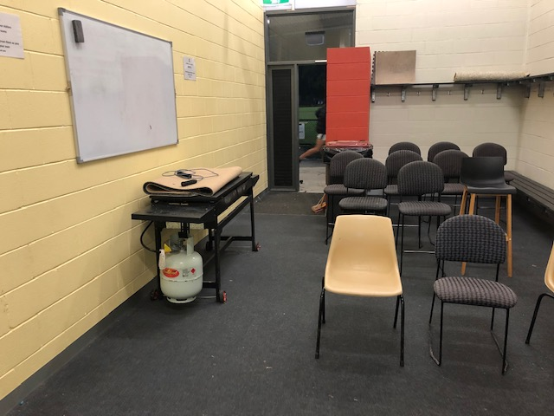
PURPOSE
Notes:
. Darley Under 17 boys – near Bacchus Marsh and Melton.
(slide 7) 2 sessions, the girls got the main rooms, I got the away change rooms, concrete floor, bench seats around the walls and a urinal. Looked like this only much worse – the kids looked like…

Slide 8
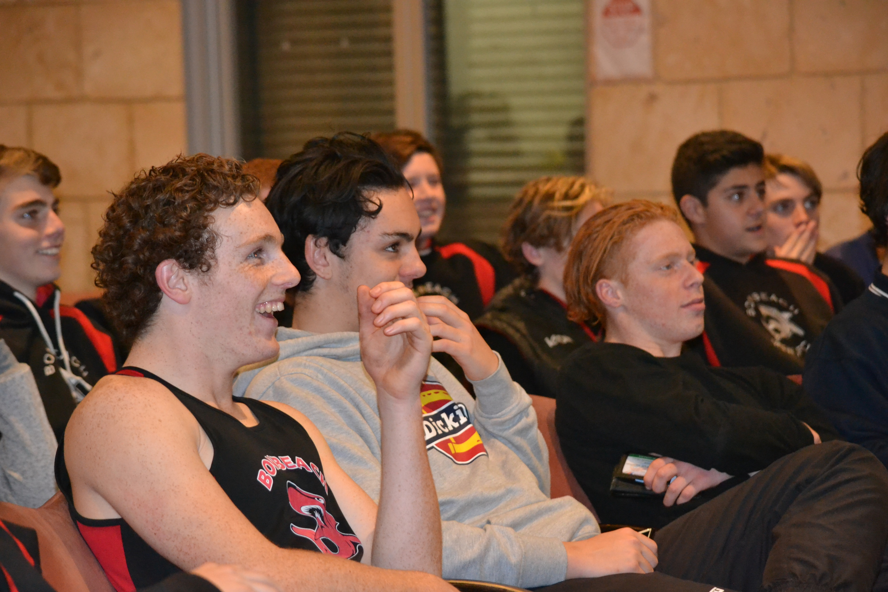
Notes:
Once again, it was not a nice space but it was clearly their space. At the end of the session, they agreed to take their dedication to each other on the football field and apply it to the party they were attending the next night. They agreed that not one of them would drink. Despite the best efforts of the Melton boys and the Bacchus Marsh boys to convince them of the error of their ways, they stayed true to their commitment and their parents wrote to the club the next day to ask what an earth had got into their boys to act so responsibly in public.
Why did they do this? Because there was a pre-existing commitment to being a team that was striving to beat the other teams. It was tribalism, it was a competitive challenge, it was building on a set of beliefs that they knew were shared among the group.

Slide 9
Notes:
For these 2 events to happen there had to be leaders in the group who set the tone.
As the main leader of the session, I had to discover what we call the champions in the room. Those who would go first and tell their stories or put their hands up and commit not to drink at the party.
So this environment was conducive enough and there was enough trust and belief for them to move beyond their comfort zones, which was a good thing.
But in a way it was a bad thing. To set the conditions to open up and become better at sharing or committing there was a fairly narrow set of parameters and some of these were negative or limiting.
In the first story, alcohol, comedy, bravado and good natured put downs were valued. This can create a fragile environment. The reliance on alcohol can mean that the healthy environment can be easily damaged. It may only take one good natured put down that isn’t really good natured or is misinterpreted and someone quickly takes offense and leaves.
It obviously requires the unhealthy reliance on alcohol. So if that type of behaviour doesn’t suit you, then you are going to quickly feel isolated and exposed.
In the second example with the younger boys, we can have a burst of energy around being our best and not drinking at the party but unless there some leaders who will take this momentum and continue to build on it, the initial impetus will quickly die.
In our Clubs with Heart series we talk about stages of change and use this model. (slide 9)

Slide 10
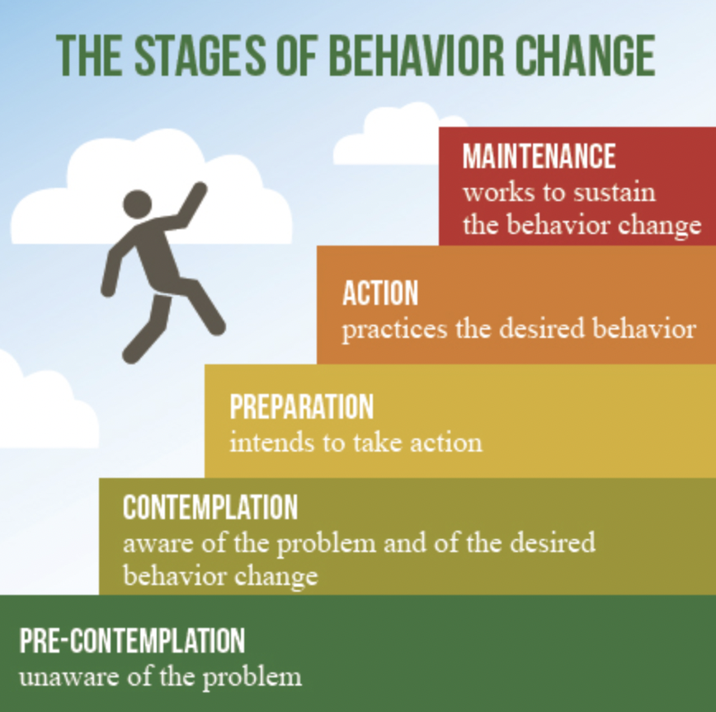
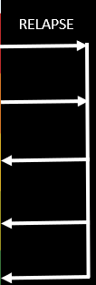
5 STAGES OF CHANGE
Notes:
The hardest part of the change process is maintenance and if the conditions for men to be at their best are too narrow or selective then it is going to be hard to maintain consistently.
We started SALT because we could see the possibilities of what men look like at their best.
The challenge is to spread the times and the locations of when they are at their best more widely. From the sporting environment to their homes, schools, workplaces.
So, to conclude, we reckon places like sporting clubs where men feel comfortable to share and trust are great starting points and the research confirms this (slide 10)

Slide 11
WHY SPORTING CLUBS?
“Internationally, youth sport settings have been recognised for their contribution to children’s positive youth development via optimal social climates, a focus on life skill development and positive developmental outcomes spanning social, personal, and physical domains. Additionally, community sport settings are gaining momentum as an efficacious site for the delivery of mental health and wellbeing interventions.”
Understanding the impact of COVID-19 on youth sport in Australia and consequences for future participation and retention Sam Elliott1* , M. J. Drummond1, I. Prichard1, R. Eime2,3, C. Drummond1 and R. Mason1,4
Notes:
But sustained improvement in the quality of men’s and women’s lives requires these safe places to expand their vision of leadership, empowerment and outreach to others.

Slide 12
https://clubswithheart.com.au/
Notes:
Anyone interested
https://clubswithheart.com.au/
20th June

